Slide 1

Vitamin Deficiency Detection Using Image Processing and Neural Networks
by
R. Pallavi
Roll No. 204G1A0569
M. Sai Kiran
Roll No. 204G1A0586
C. Vamsi
Roll No. 214G5A0512
G. Sreekar Vamsi krishna
Roll No. 204G1A05A1
Under the guidance of
P. Shajahan M.Tech.
Assistant Professor
Department of Computer Science and Engineering
Srinivasa Ramanujan Institute of Technology
(Autonomous)
2023 - 2024

Slide 2

Contents
Review-0 Comments
Abstract
Problem statement
Objectives of Project
Literature survey for first objective
Objective-1(Design & Implementation)
Literature survey for second objective
Objective-2(Design & Implementation)
Proposed Work -(Methods to be followed for proposed system)
References
GitHub Link
Queries

Slide 3
Review 0 Comments
Where do you get the datasets from?
We have taken the data sets from an online website “Kaggle”. Kaggle Datasets provide resources for storing and processing datasets. It is a popular data-science competition website that provide free public datasets.
What are the datasets used in your project?
We are using the datasets which include images of eyes, lips, tongue, nails.
What is CNN?
CNN stands for Convolution Neural Networks is a network Architecture for deep learning that learns directly from data. CNN’s are particularly useful for finding patterns in images to recognize objects, classes and categories.

Slide 4
Review 1 Comments
What are the CNN layers?
CNN is a multilayer algorithm. It has three layers namely convolutional, pooling, and a fully connected layer.
How many layers are used in this project?
We have used three layer in our project. Initially convolutional layer apply filters to input image, extracting features like shape, textures and edges.
Pooling layers reduce the spatial dimensions of features and make the network more computationally efficient.
Fully connected layer combine the extracted features and make predictions based on them.

Slide 5
Abstract
A wide spectrum of vitamin deficiencies can show one or more visually distinguishable symptoms and indications that appear in multiple locations in the human body. The application provides individuals with the capability to diagnose their possible vitamin deficiencies without the need to provide blood samples through the analysis of photos taken of their eyes, lips, tongue, and nails.
This process is implemented using the deep learning based ANN, CNN, MobileNet algorithms. Here we have considered the dataset of eyes, lips, tongue and nails. Once after the consideration of dataset, the pre-processing is performed and then respective algorithm is used to train and test the data.
Keywords: Vitamin Deficiency, CNN, ANN.

Slide 6
Problem Statement
The challenge at hand is to develop an automated system utilizing deep learning and CNN algorithms that can diagnose potential vitamin deficiencies by analyzing photographs of the eyes, lips, tongue, and nails, eliminating the need for invasive blood tests.
This research aims to address the lack of a non-invasive, visual-based method for early detection of vitamin deficiencies, necessitating the creation of an accurate and reliable model capable of identifying distinct visual symptoms across different body areas.
Notes:
Make first as two point…..no aim

Slide 7
Objectives of Project
Objective-1: Implement a comprehensive dataset collection and preprocessing strategy for eyes, lips, tongue, and nails images, followed by training and fine-tuning the ANN model to recognize a diverse range of visual symptoms associated with various vitamin deficiencies, leading to an effective and accessible diagnostic tool.
Objective-2: To develop an user-friendly interface, on uploading the images of eyes, lips, tongue and nails detect’s the vitamin deficiency of the person.

Slide 8
Literature survey for first objective
The study focuses on the global issue of vitamin deficiency, which affects billions of people, particularly children and pregnant women[1]. The current procedures for identifying deficiencies involve unpleasant blood tests, which are pricy and uncomfortable. In order to address this issue, the research presents a cutting-edge desktop program powered by AI that lets users upload pictures of particular body parts like the eyes, lips, tongue, and nails. The AI analyzes these photos to find any probable nutritional deficiencies and produces reports with dietary advice[3]. The AI, which has been trained to distinguish between positive and negative traits. The system generates precise diagnoses by utilizing image processing, deep learning, and methods. The study highlights the need to address vitamin deficits immediately, as well as the potential future expansions to cover a wider range of health issues

Slide 9
Design and implementation of first objective
start
Vitamin deficiency image dataset
Pre-processing
Training
Testing
Classification
Fig:1 Block Diagram

Slide 10
Data Flow Diagram
Take dataset
Preprocessing
System
DataStore
Training
User
Classification
View results
Fig:2 Data Flow Diagrams

Slide 11
UML DIAGRAMS
Dataset
Preprocessing
Training
Classification
System
User
View Results
Fig:3 Use-Case Diagram

Slide 12
Activity Diagram
System
User
Take Dataset
Preprocessing
Training
View results
Classification
Fig:4 Activity Diagram

Slide 13
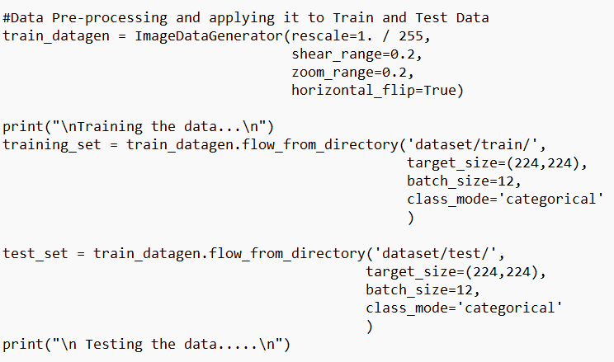
Design and Implementation of first objective
Implementation

Slide 14
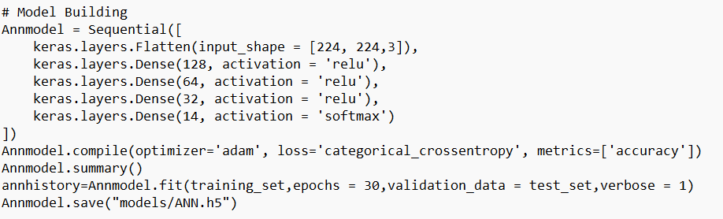
Design and Implementation of first objective
Model Bulding

Slide 15
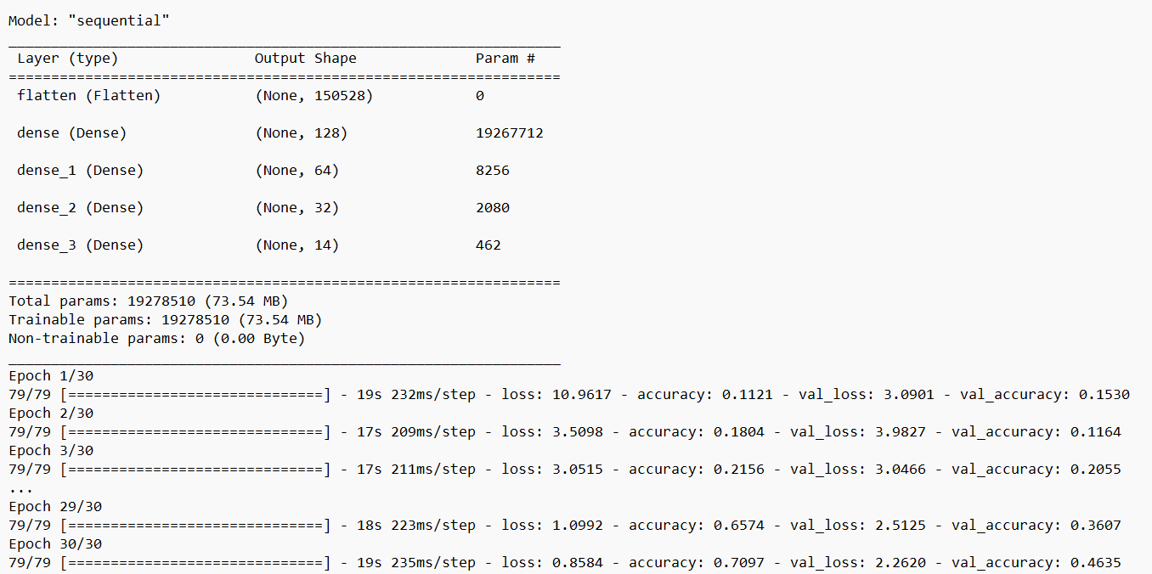
Design and Implementation of first objective
Executed Output

Slide 16
Literature survey for second objective
The study describes a free smartphone app that makes use of AI to identify vitamin deficiencies in people by analyzing photos of particular body parts[2]. Unlike traditional laboratory analysis, this novel method makes use of physical signs of deficits, such as those seen in the lips, tongue, eyes, and nails. The application uses these photographs to train a neural network to extract features, and a fuzzy logic decision-making algorithm then determines any flaws. The suggested remedy, Vita-Cam, provides an easy way for self-diagnosis without requiring blood samples. Through the combined effort of medical practitioners and experts, the accuracy and significance of the diagnosis can be further improved.

Slide 17
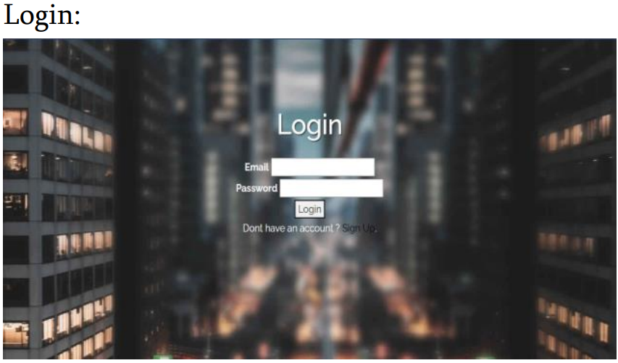

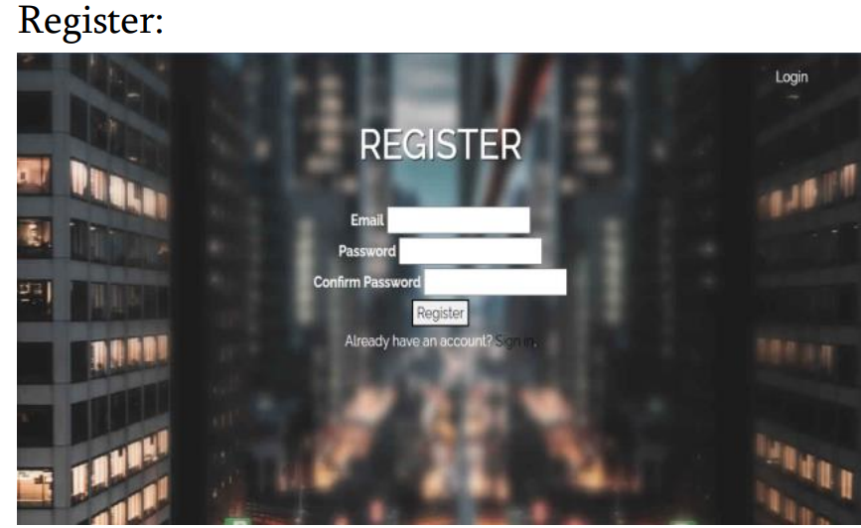

Design and Implementation of second objective
MODULES

Slide 18
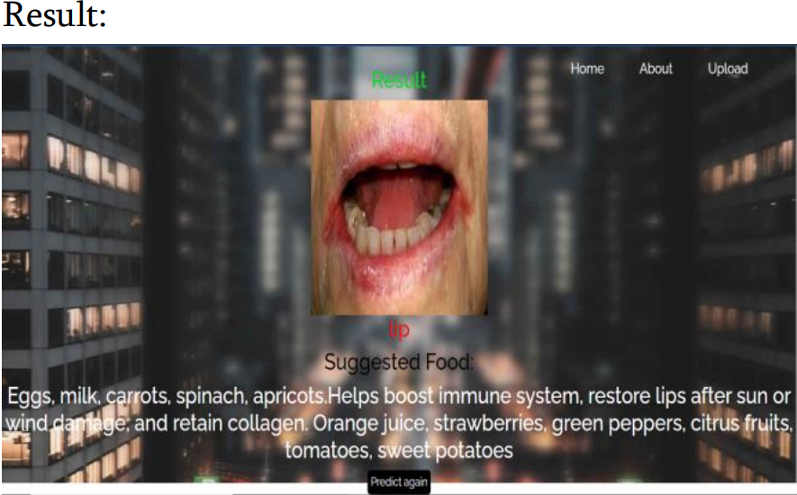
Design and Implementation of second objective
MODULES

Slide 19
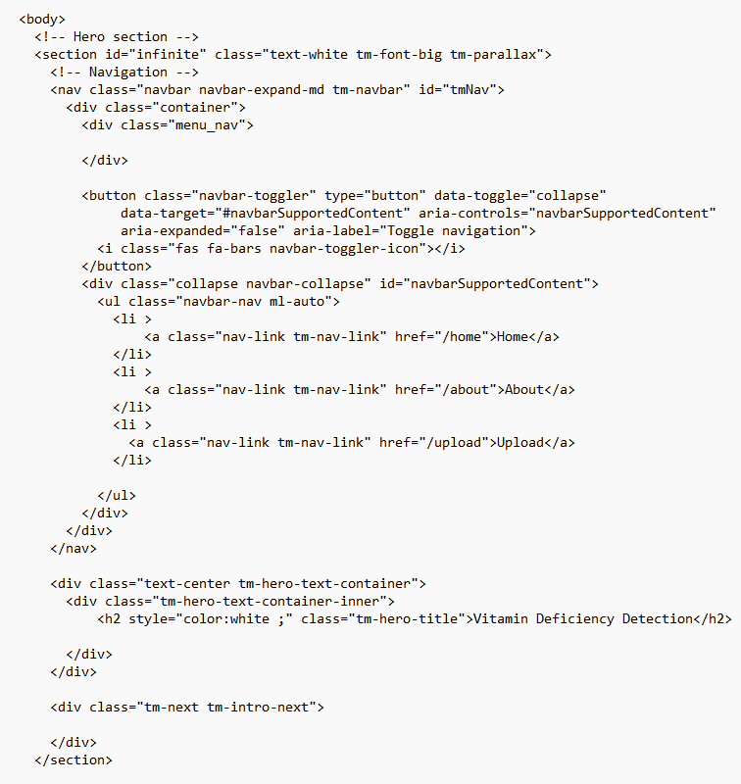
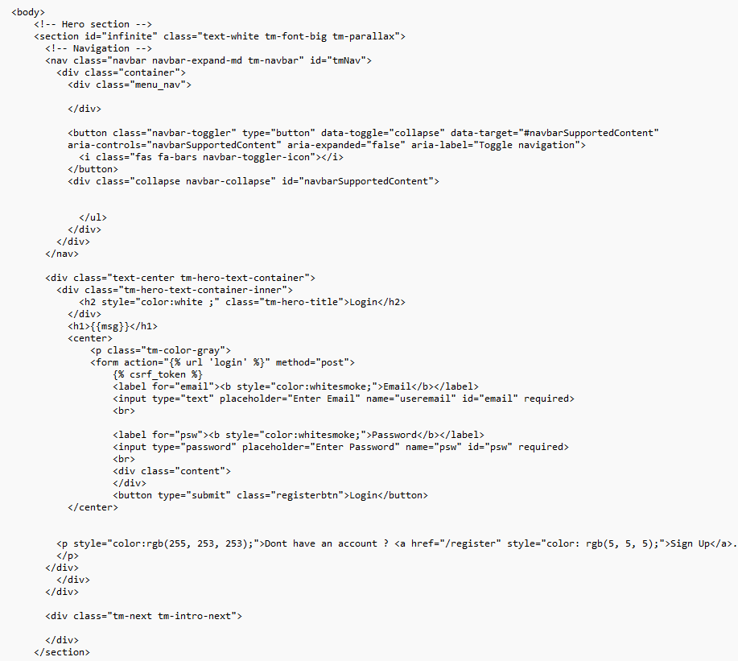
Design and Implementation of second objective
MODULES CODE
LOGIN REGISTER

Slide 20

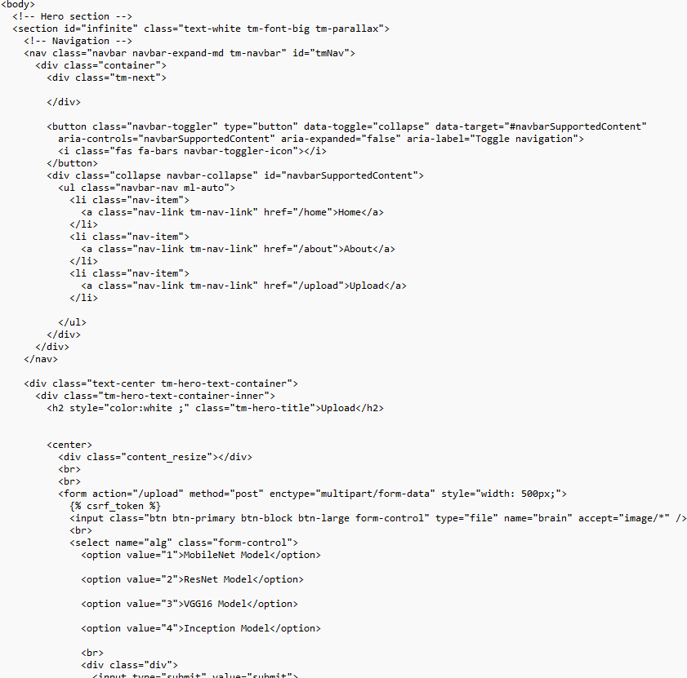
Design and Implementation of second objective
MODULES CODE
UPLOAD RESULT

Slide 21
Design and Implementation of second objective
Login
Login Exists
Login Not Exists
Register
Result
Home Page
Submit
Home
About
Upload
Fig5. Use Case Diagram

Slide 22
Proposed System
The application provides individuals with the capability to diagnose their possible vitamin deficiencies without provide blood samples through the analysis of photos taken of their eyes, lips, tongue, and nails. To implement the automatic identification we used the deep learning based CNN algorithm. By applying this model we will classify the vitamin deficiency with high accuracy.
By using this process user will get the results very fastly and efficiently also, for that we design a desktop application so that user can easily interact the model. For desktop application designing we consider the flask flamework to build a user interface.
Notes:
Use the chat gpt…add more points……

Slide 23
References
[1]. Ahmed Saif Eldeen, Mohamed AitGacem, Saifeddin Alghlayini, Wessam Shehieb and Mustahsan Mir, “Vitamin Deficiency Detection Using Image Processing and Neural Network”, IEEE Xplore, vol. 10, pp. 514-519, Jul.2020.
[2].Rutuja Moholar, Mansi Kamie, Gauri Bobade, Saijyoti Shinde, “Vitamin Deficiency Detection Using Image Processing and Neural Network”, International Journal of Advance Research and Innovative Ideas in Education-International Standard Serial Number(IJARIIE-ISSN), vol. 9, pp. 4175-4182, Mar.2023.
[3]. Khenilyn P. Lewis, Juancho D. Espineli, “Classification And Detection Of Nutritional Deficiencies In Coffee Plants Using Image Processing And Convolutional Neural Network (CNN)”, InternationalJournalOf Scientific & Technology Research (IJSTR), vol. 9, pp. 2076-2081, Apr. 2020.

Slide 24
References
[4]. Alfred Sommer, “Vitamin A Deficiency and Clinical Disease”, The Journal of Nutrition, vol. 10, pp. 1835-1839, Feb.2018.
[5]. Uwe Wollina, Pietro Nenoff, Gunter Haroske, Holger A. Haenssl, “The Diagnosis and Treatment of Nail Disorder”, Deutsches Arzteblatt International , vol. 9, pp. 509-518, Mar.2016.

Slide 25
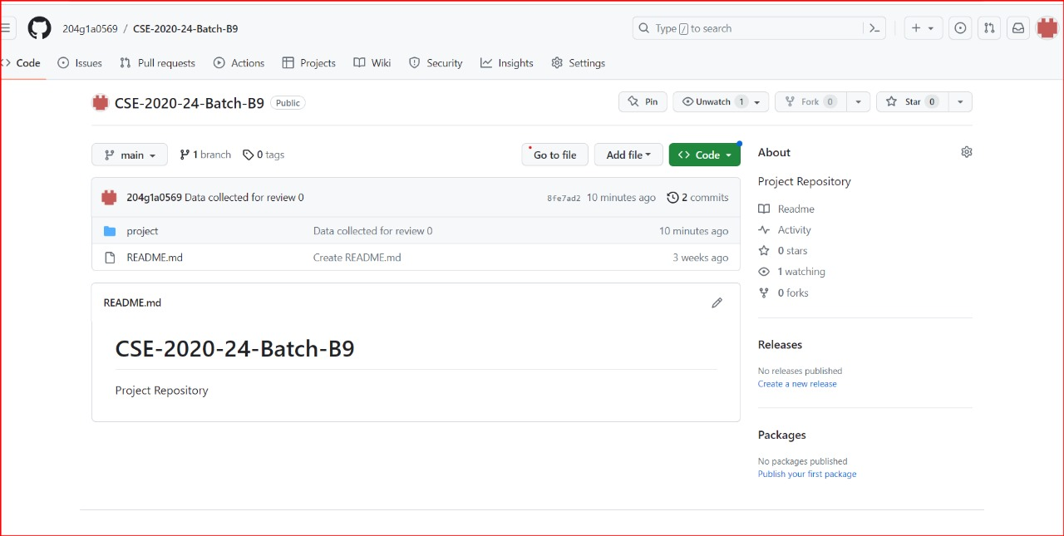
Git Hub Dashboards of each student
Git hub link : https://github.com/204g1a0569/CSE-2020-24-Batch-B9

Slide 26
Any Queries?

